Slide 1
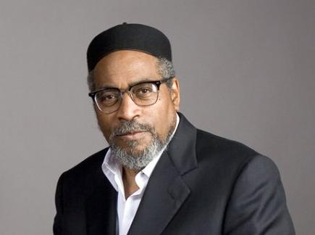
14th Annual Juanita Kidd Stout Financial Empowerment EXPO
“Come with a Vision, Leave with a Plan”
Kenneth Gamble
Founder/Chairman, Universal Companies
Join us!
Sat., April 8, 2017
9:00 a.m. – 1:00 p.m.
Universal Audenried Charter
High School
3301 Tasker Street
Philadelphia, PA 19145
This annual event gives youth and adults important information to strengthen their financial foundation!
Highlights include:
Keynote address by legendary songwriter and entrepreneur Kenneth Gamble
Continental Breakfast
Small Business Start-up Information
Entrepreneurs Showcase
*** On-site registration and breakfast begin at 8:15 a.m. ***
No charge for youth in grades 5 – 12; Adults 18 & over must pay a $5 registration fee
For more information,
please email jks@phillyalumnae-dst.org or visit www.phillyalumnae-dst.org

